Slide 1
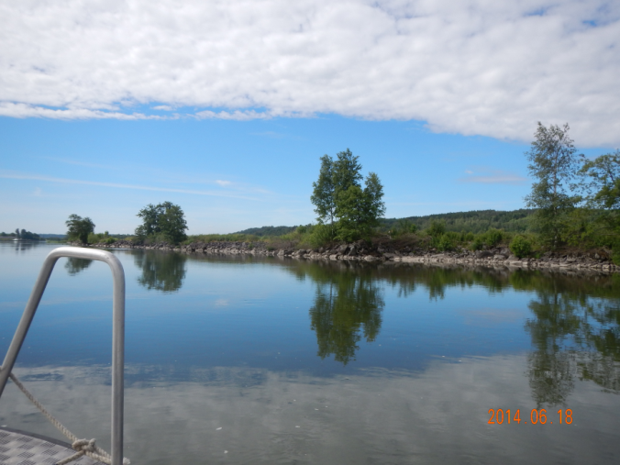
Official on call at SGI
HannaSofie Pedersen
Swedish Geotechnical Institute, SGI

Slide 2
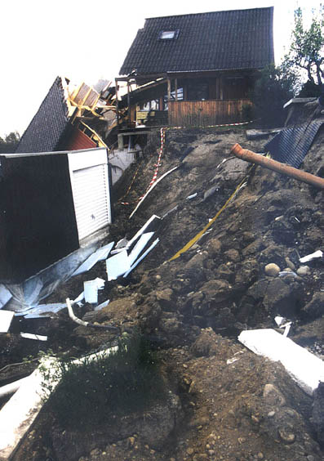
Official on call
Mission assigned by the Swedish Government 2014
”… to initiate and coordinate the initial work to discover, verify, alert and inform in case of serious disaster”
Important to be able ”awaken” the authorities

Slide 3
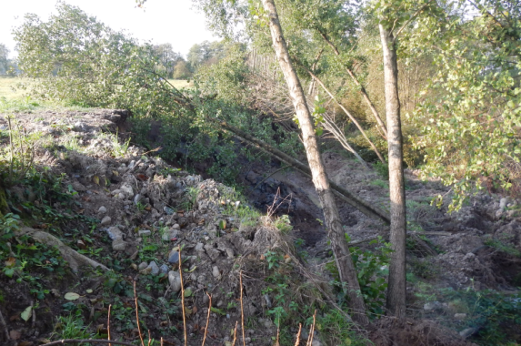
Preparedness at SGI through the years
Small group of geotechnical engineers
Help provided if possible, as soon as possible
But: no regulations

Slide 4
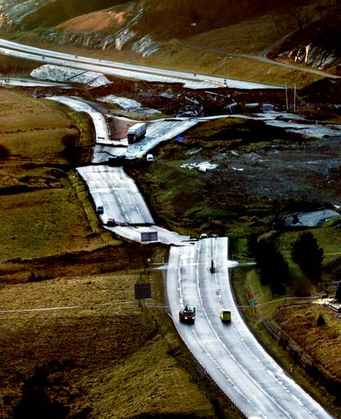
Preparedness at SGI today
Since Dec 1st 2015: official on call
On call every hour, every day
10-15 geotechnical engineers on
rotational basis
Småröd 2006

Slide 5
Responsibilities
Reachable on phone at all times – every hour, every day of the week
Able to reconnect to rescue services within 15 min
Ready for Skype-/telephone meeting with other organizations within 1 hour
If needed, provide geotechnical assistance* in the field (SGI and rescue services decides the need)
*geotechnical assistance regarding landslide incidents

Slide 6
Every day work for an offical on call
Be the contact of SGI towards rescue services and other authorities
Keep a logbook of actions taken
Participate in weekly telephone conferences held by MSB (the Swedish Civil Contingencies Agency)

Slide 7
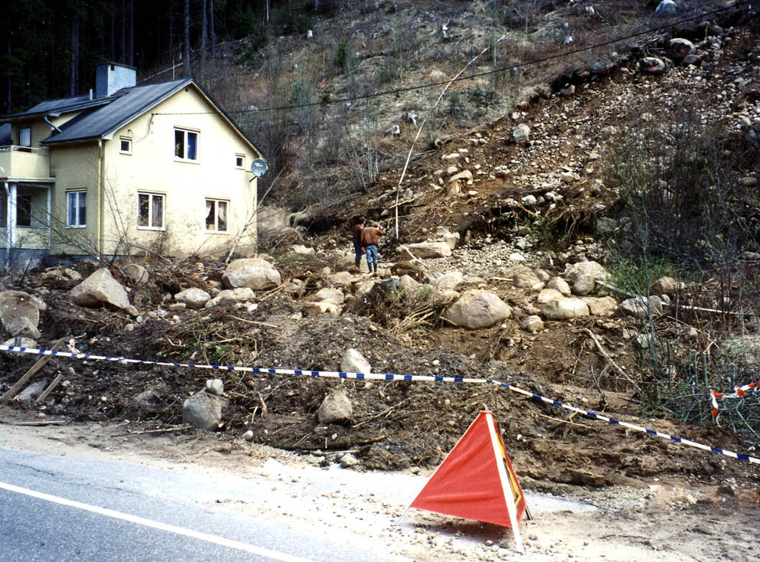
In case of emergency
At home/at the office:
Is our presence needed?
Find out about geological and
geotechnical conditions
Find out information about:
  position
  surrounding areas
  damages
  actions taken
Sysslebäck, Torsby

Slide 8
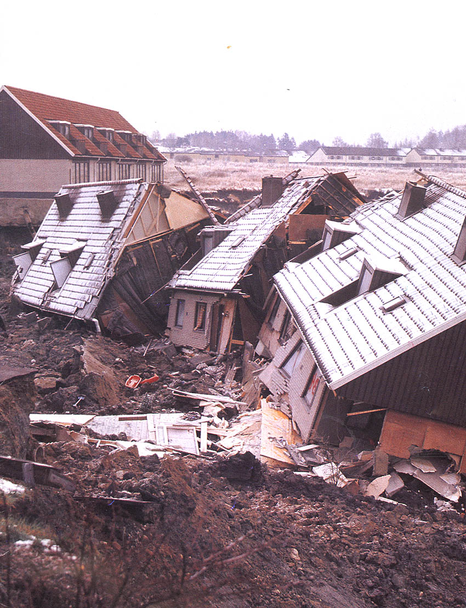
In case of emergency
At site:
Provide geotechnical assistance to
rescue services:
  Situation assessment from a geotechnical
  view
  Threat assessment
  Inspect the area
  Look for signs of further landslides
Tuve 1977

Slide 9
In case of emergency
  Decide if it is needed to enclose the area
  Recommend what emergency actions to take
  Recommend geotechnical surveys and investigations
  Inform persons in question about the situation

Slide 10
Ongoing education
Education for officials on call held by MSB (the Swedish Civil Contingencies Agency)
Study visist at landslide sites, rescue services etc.
Monthly meetings with the group of officals on call
  Used to strengthen the group of officals on call
    - geotechnically
    - within the area of preparedness

Slide 11
Thank you!

