Slide 1
Emergency Rescue Services GIS web applications for natural disasters
Three modern web-based applications
EMERGENCY_RESCUE_SERVICES_FIELD
GEO_EXPERT
GW_POLLUTION_EXPERT
can improve and enhance cooperation between emergency rescue services and expert authorities by better use of existing geodata to solve problems and implement measures during imminent danger of landslides and chemical spill in sensitive areas.
Mats Öberg, GIS-architect, M.Sc. Civil Engineering
Swedish Geotechnical Institute
mats.oberg@swedgeo.se
Ph: +46 709730129
Kobe Fire Department Landslide
Procedures Research Visit
Jan 11-13 2016

Slide 2
These applications have been developed in cooperation between:
Swedish Geotechnical Institute
Swedish Geological Survey
Emergency Rescue Services BOHUS
Swedish Association of Local Authorities and Regions
National Land Survey
Swedish Civil Contingencies Agency
Use of standardized data from the Swedish National Geodata portal
Tailor made for emergency rescue applications – still general ”ready-to-use” GIS web tools
Platform independent (PC, Mac, iPad, mobile phones etc). Support form GPS location. Central database storage of active editable layers

Slide 3
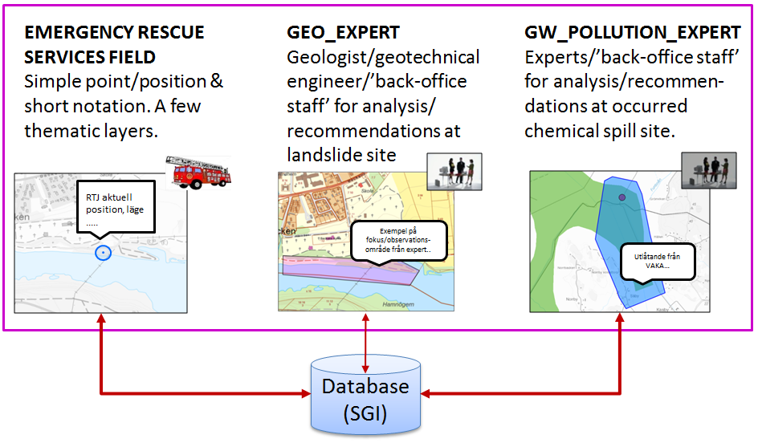
Active (editable) layers
http://gis.swedgeo.se/rtj/en/

Slide 4
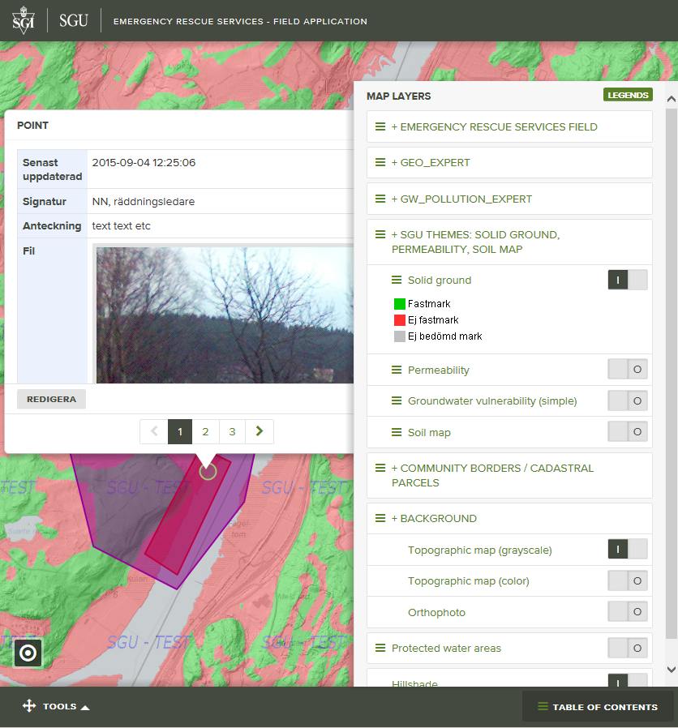
EMERGENCY RESCUE
SERVICES FIELD

Slide 5
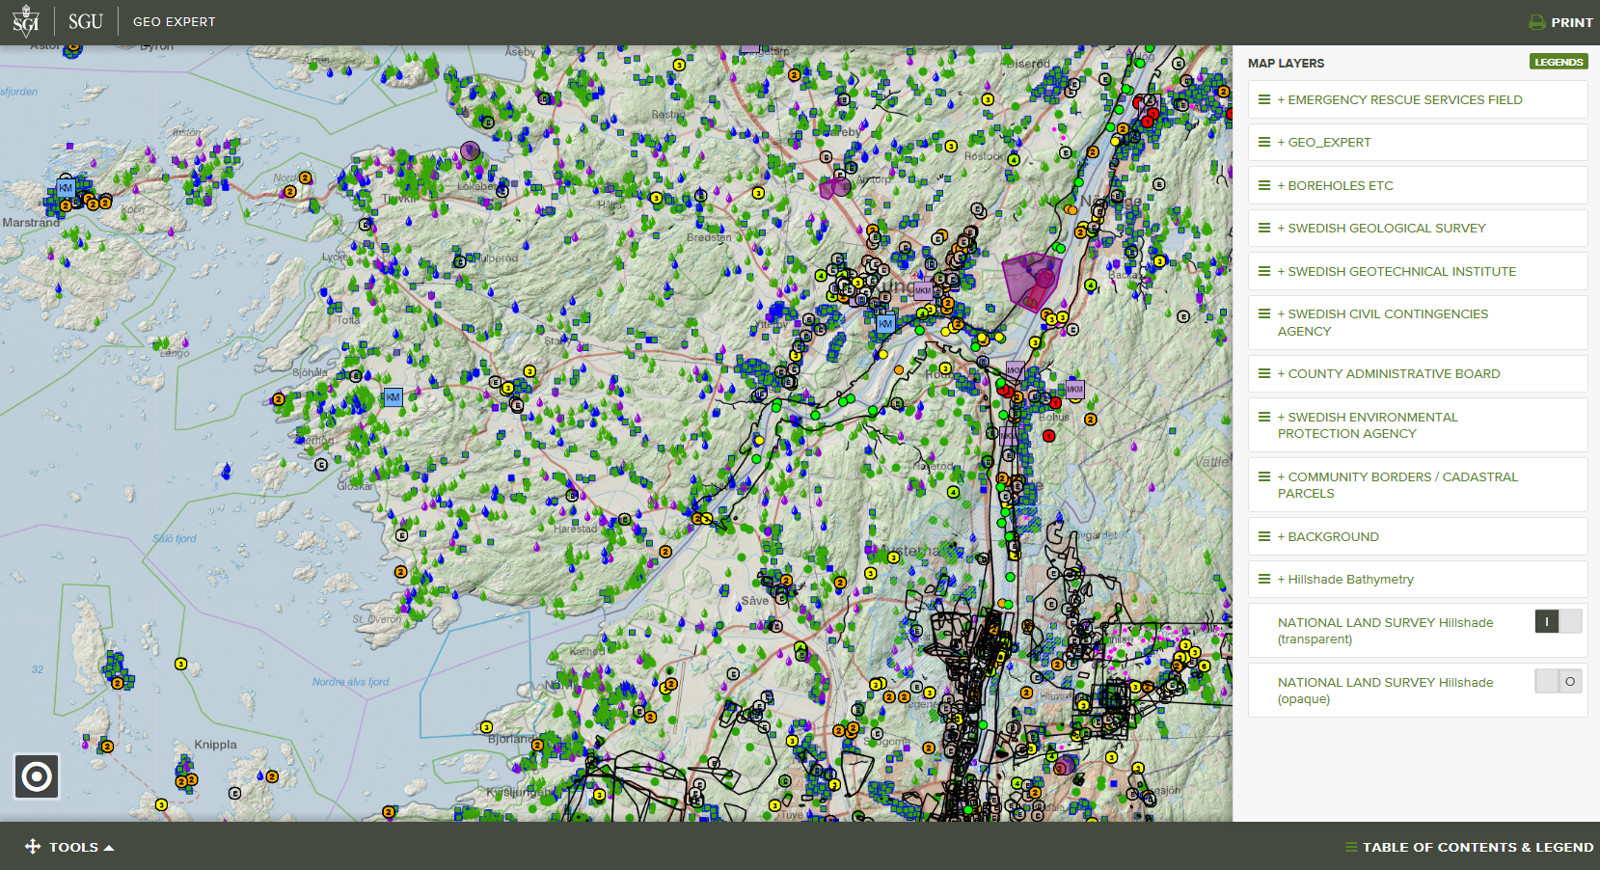
GEO_EXPERT

Slide 6
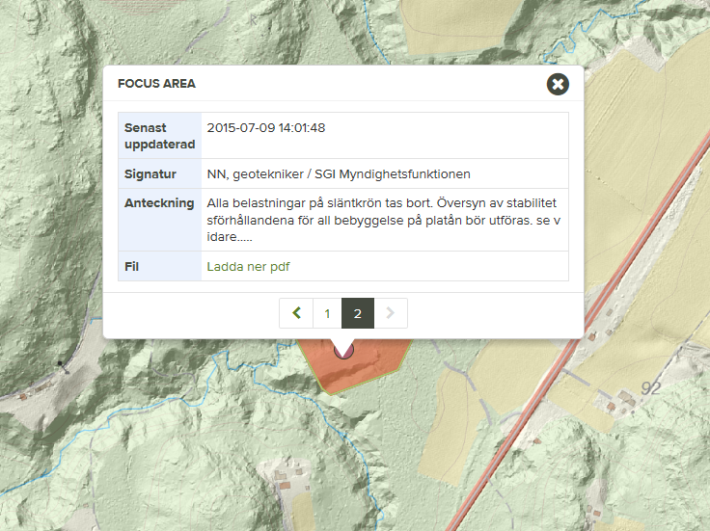
Components in EMERGENCY RESCUE
SERVICES FIELD application – simple and robust
Rescue services staff use GPS to identify and store their position (point) + attach photo. Draw area, e.g. barrier
Detailed topographic map for Sweden
Specific soil theme layers such as “Solid ground” and “Permeability”
View focus area/recommendation drawn by geotechnical expert. View uploaded pdf.
Components in GEO_EXPERT – many geological/ geotechnical layers for analysis, extended functionality

Slide 7
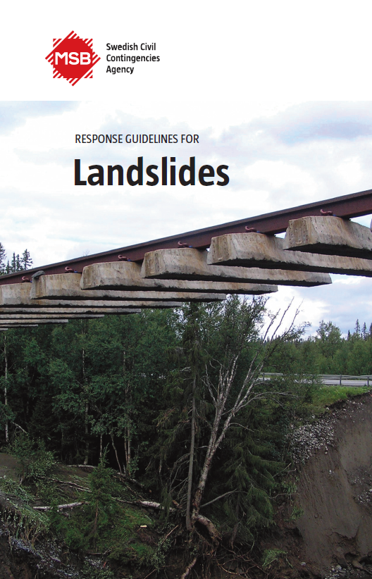
Workflow actions according to MSBs ”Response guidelines for Landslides” ^{*)}
When there is an indication of a possible
pre-stage to a landslide (page 7):
Take out available and relevant map data….
Analyze risks in the area, in consultation with a geotechnical expert, using support maps and observation….
The use of EMERGENCY_RESCUE_SERVICES_FIELD and GEO_EXPERT web applications can indeed facilitate these procedures (remark by Mats Öberg).
*) https://www.msb.se/RibData/Filer/pdf/27282.pdf - Vivian will present this on day 2

Slide 8
DEMO

Slide 9
Possible MSB-financed project ”Geotechnical analysis to support international rescue operations” ?
Course material and handbook regarding mudflow characteristics - for SWIFT-USAR (Swedish International Fast response Team - Urban Search And Rescue)
GIS-analysis to pinpoint areas “Slope analysis – where can mudflows occur?” (study areas in Western Balkans, including collection and assessment of various sources for terrain models and soil maps)

Slide 10
